Slide 1

Big Data Visual Analytics (CS 661)
Instructor: Soumya Dutta
Department of Computer Science and Engineering
Indian Institute of Technology Kanpur (IITK)
email: soumyad@cse.iitk.ac.in

Slide 2
Acknowledgements
Some of the following slides are adapted from the excellent course materials and tutorials made available by:
Prof. Han-Wei Shen (The Ohio State University)

Slide 3
Study Materials for Lecture 8
Parallel Algorithms:
https://hpc.llnl.gov/documentation/tutorials/introduction-parallel-computing-tutorial
Parallel Volume Rendering Using Binary Swap Image Composition, Ma et al.
Parallel Volume Rendering on the IBM Blue Gene/P, Peterka et al.

Slide 4
Accelerating Volume Rendering
Early ray termination
Empty space skipping
Adaptive sampling

Slide 5
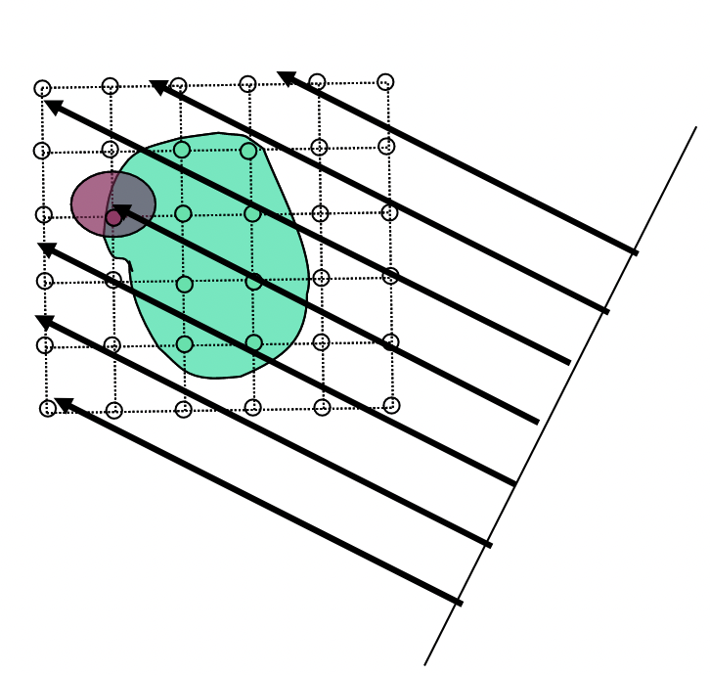
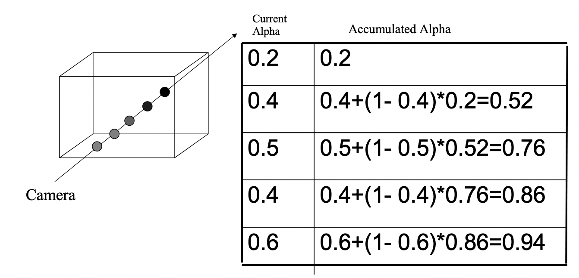
Early Ray Termination
In front to back compositing, we keep track of accumulated opacities separately
We can stop ray traversal when accumulated alpha/opacity for a ray reaches 1 and nothing behind will be visible

Slide 6
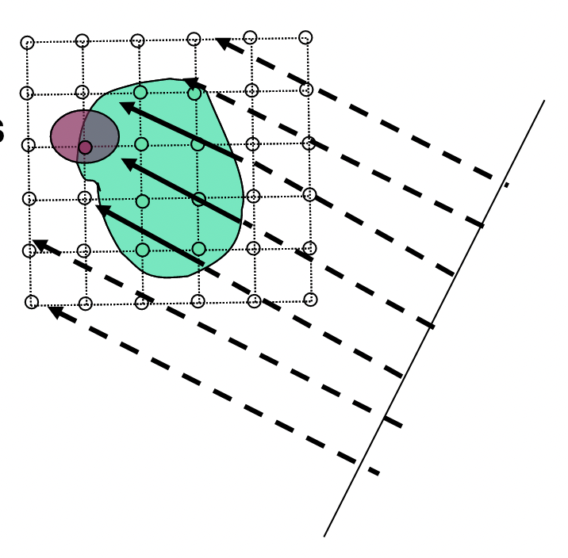
Empty Region Skipping
Skip Empty Cells
Homogeneity acceleration
Approximate homogeneous regions with fewer sample points

Slide 7
Adaptive Sampling
Increase sample density in high-gradient regions
Decrease sample density in low-gradient/homogeneous regions

Slide 8
Dealing with Large-Scale Data via Parallel Data Processing and Visualization

Slide 9
Why Parallel Programming?
Utilize the aggregated memory from all computing elements to store very large data sets
Utilize the aggregated compute power to share the expensive task workload
Utilize the aggregated I/O bandwidth, if a parallel file system is available
Data computed from large scale simulations are typically stored in a file system connected to a supercomputer

Slide 10
Parallel Computing Paradigms
Shared-memory parallelism
Distributed-memory parallelism
Hybrid parallelism

Slide 11
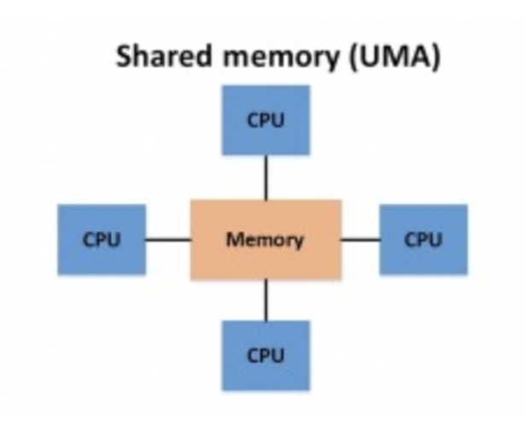
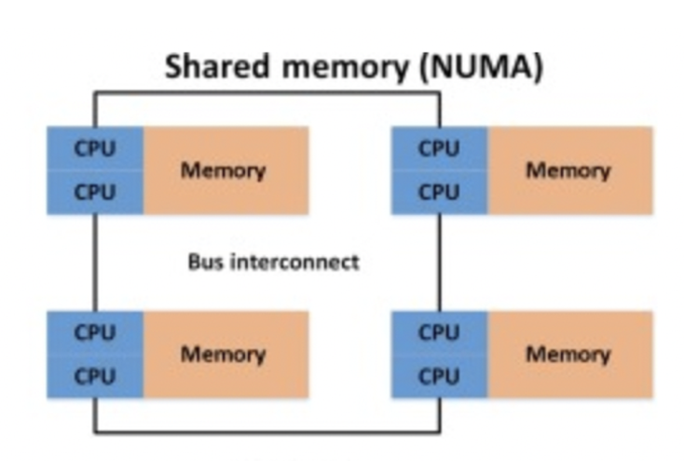
Shared Memory Parallelism
Shared-memory parallelism
All PEs can access the shared memory, hence have the same view of the data
No explicit message passing is needed
Computation are done through multiple threads, or libraries such as OpenMP
https://hpc.llnl.gov/documentation/tutorials/introduction-parallel-computing-tutorial

Slide 12
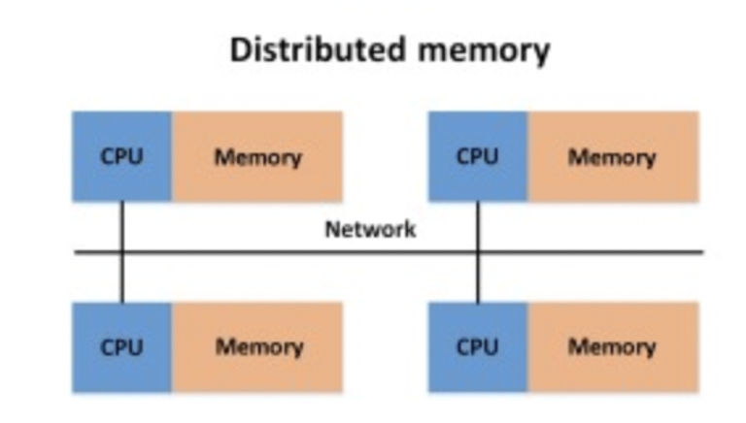
Distributed Memory Parallelism
Distributed-memory parallelism
Data are distributed across the local memory of different Processing Element (PE)
Coordination among PEs is done through message passing using libraries such as MPI
Tasks are run on each core within each processing node
https://hpc.llnl.gov/documentation/tutorials/introduction-parallel-computing-tutorial

Slide 13
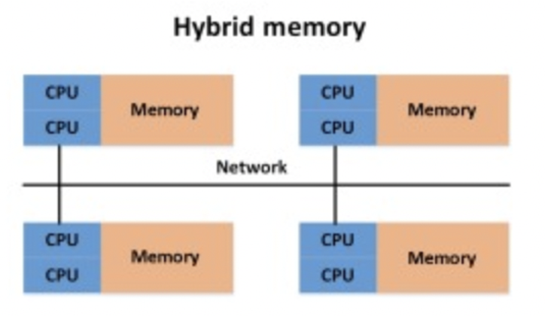
Hybrid Parallelism
Hybrid parallelism
Hybrid parallelism refers to a blend of distributed- and shared-memory parallel programming techniques within a single application
Each node has multiple threads running shared memory parallelism, but nodes have distributed memory and communicate with one another using message passing
Most modern clusters and supercomputers provide hybrid parallelism capability
https://hpc.llnl.gov/documentation/tutorials/introduction-parallel-computing-tutorial

Slide 14
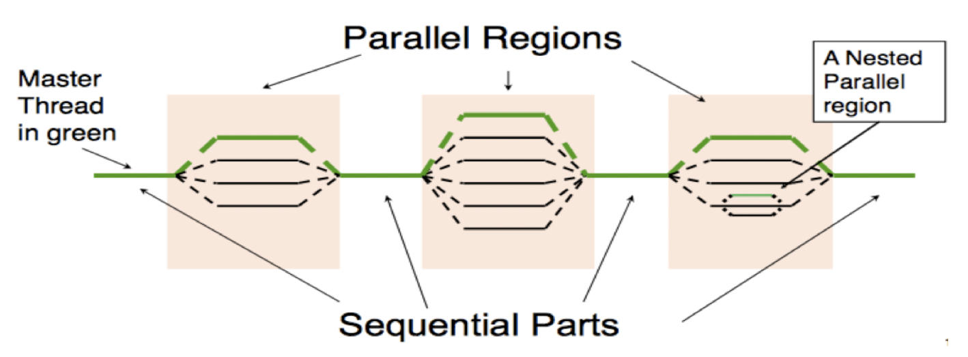
Parallel Programming API – Shared Memory
Open Multi-Processing (OpenMP) - Shared Memory Parallelism
Latest OpenMP versions also supports GPUs
https://www.openmp.org/
https://docs.nersc.gov/development/programming-models/openmp/

Slide 15
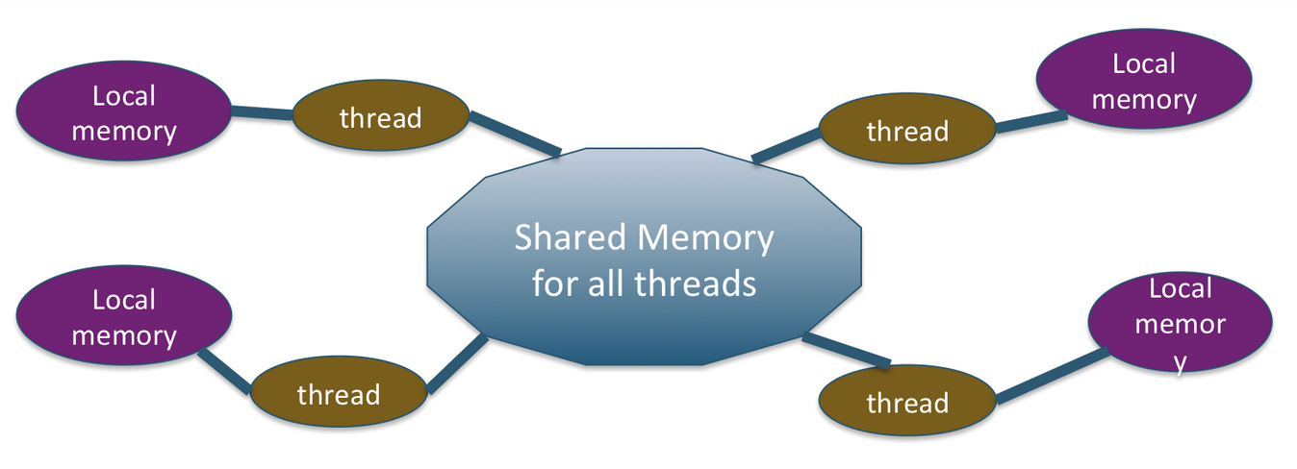
Parallel Programming API – Shared Memory
Open Multi-Processing (OpenMP) - Shared Memory Parallelism
Latest OpenMP versions also supports GPUs
https://www.openmp.org/
https://docs.nersc.gov/development/programming-models/openmp/

Slide 16
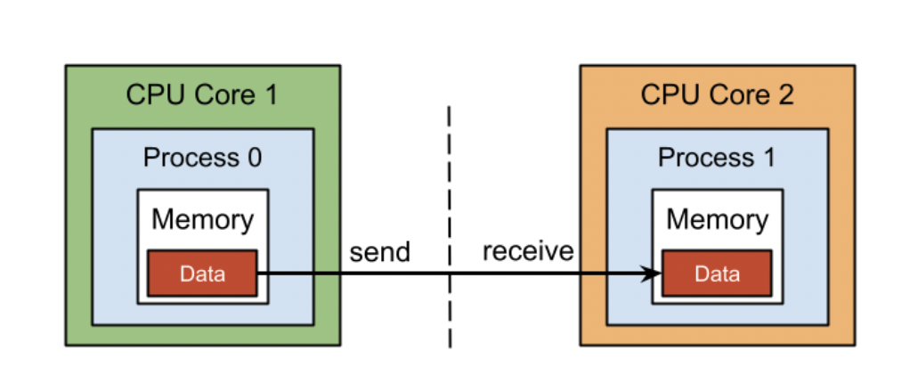
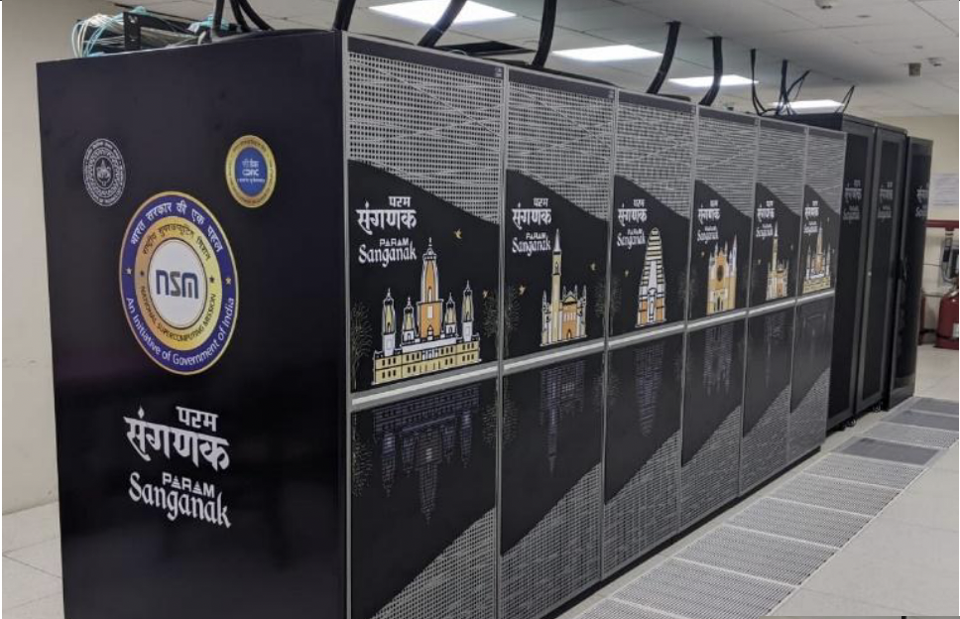
Parallel Programming API – Distributed Memory
Message Passing Interface (MPI) – Distributed Parallelism
Node 1
Node 2
Network
Different implementations of MPI:
Open MPI (https://www.open-mpi.org/)
MVAPICH (https://mvapich.cse.ohio-state.edu/)
MPICH (https://www.mpich.org/)
Param Sanganak at IITK
Total number of nodes: 332 (20 + 312)
o Service nodes: 20 (Master+ Login+ Service+ Management)
o CPU only nodes: 150 (Total 7200 cores, 28800GB memory)
o GPU nodes: 20
o High Memory nodes:78
https://www.hpc.iitk.ac.in/static/paramsanganak/documents/PARAM_Sanganak-User-Manual.pdf

Slide 17
OpenMP vs MPI
MPI | OpenMP
Available from different vendors and gets compiled on Windows, macOS, and Linux operating systems. | An add-on in a compiler such as a GNU compiler and Intel compiler.
Supports parallel computation for distributed-memory and shared-memory systems. | Supports parallel computation for shared-memory systems only.
A process-based parallelism. | A thread-based parallelism.
With MPI, each process has its own memory space and executes independently from the other processes. | With OpenMP, threads share the same resources and access shared memory.
Processes exchange data by passing messages to each other. | There is no notion of message-passing. Threads access shared memory.
Process creation overhead occurs one time. | It depends on the implementation. More overhead can occur when creating threads to join a task.
https://hpc.nmsu.edu/discovery/mpi/mpi-openmp/

Slide 18
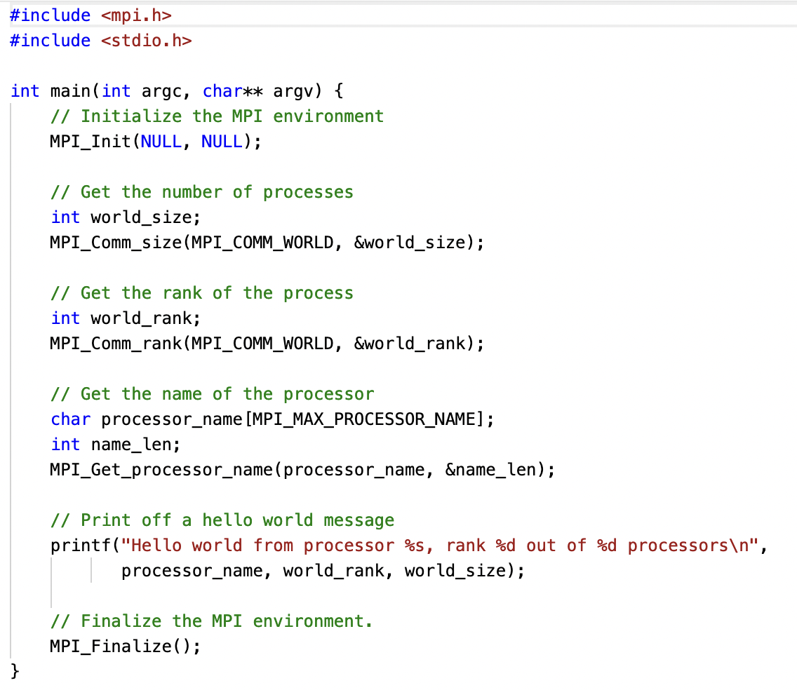
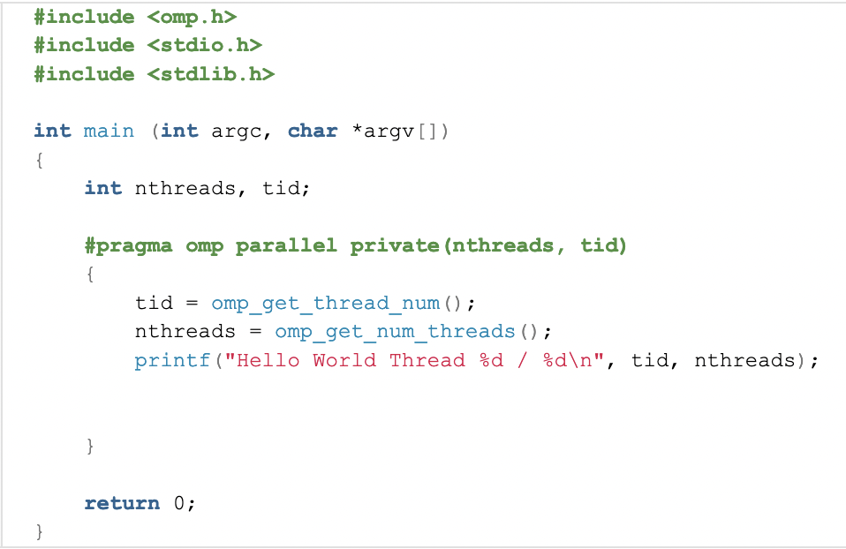

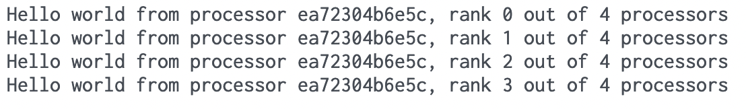
OpenMP vs MPI: Hello World

Slide 19
Steps for a Parallel Distributed Algorithm
Data Decomposition
Distribute decomposed data to processors
Parallelly process data and apply the algorithm
Aggregate partial results from different processors to produce the final result

Slide 20
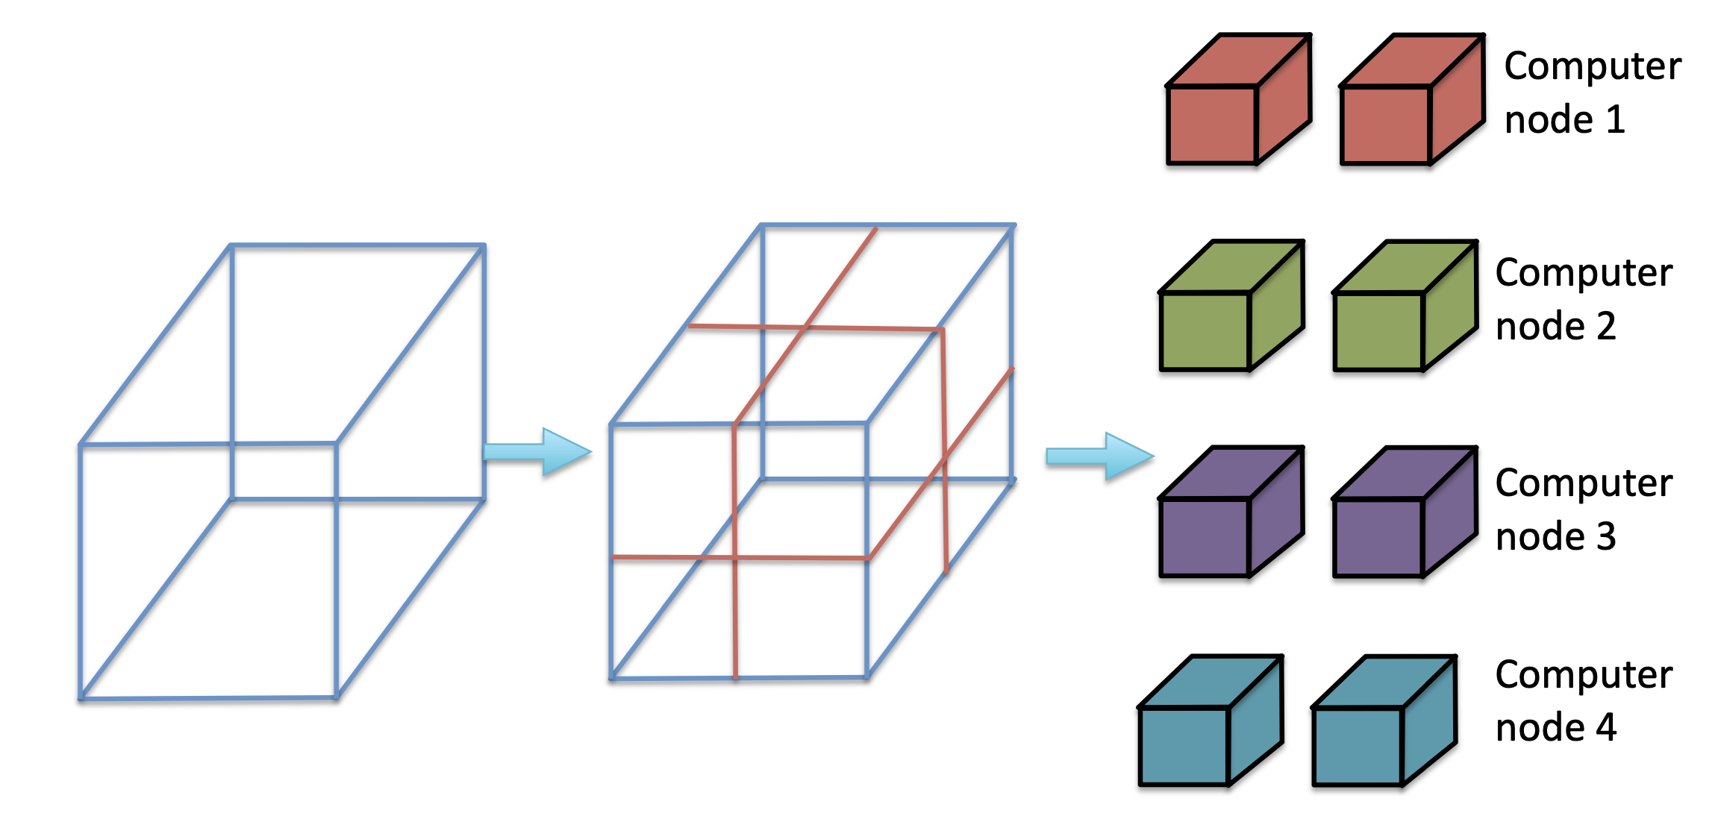
Data Decomposition
After decomposition, data blocks are distributed to processors
Large Data

Slide 21
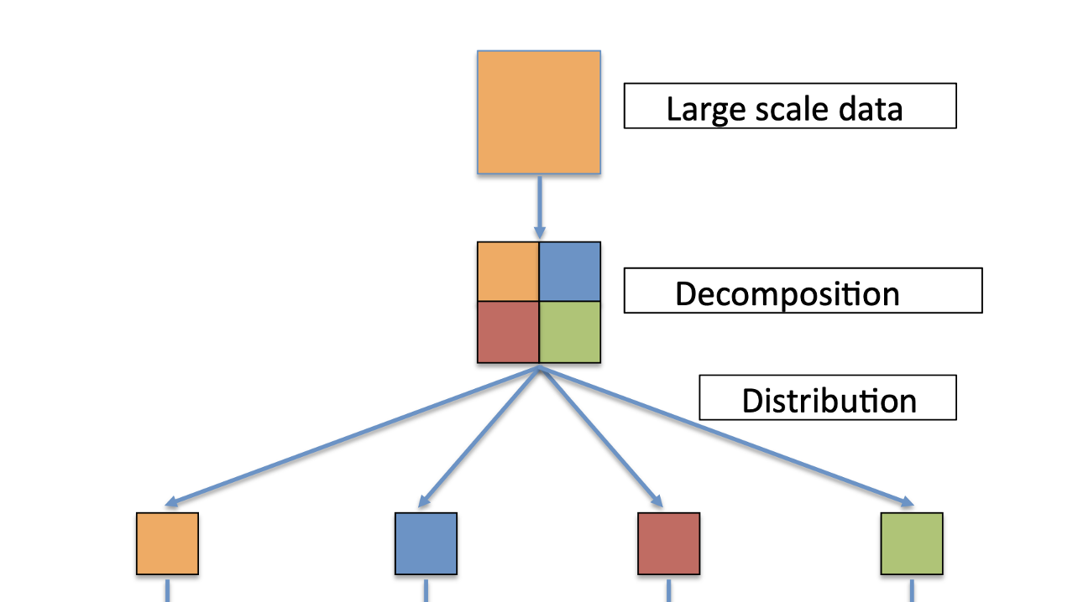
Data Distribution
After decomposition, data blocks need to be distributed to processors
Proper distribution is critical for the overall performance and minimizing overhead
What overhead?
Load imbalance
Communication of data over network among processors
Synchronization

Slide 22
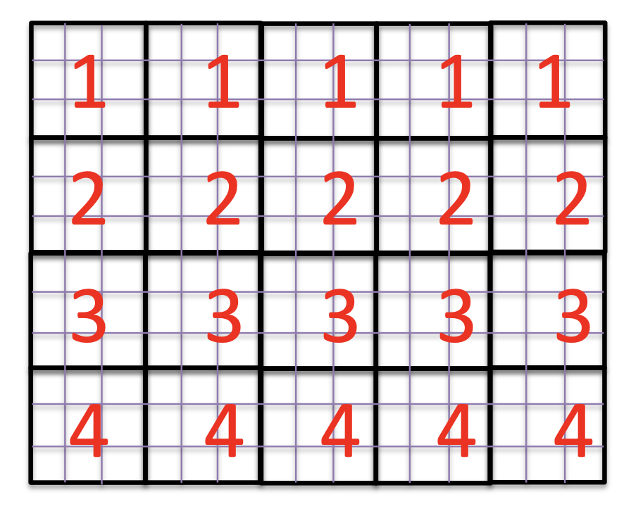
Data Distribution Techniques
Contiguous distributions

Slide 23
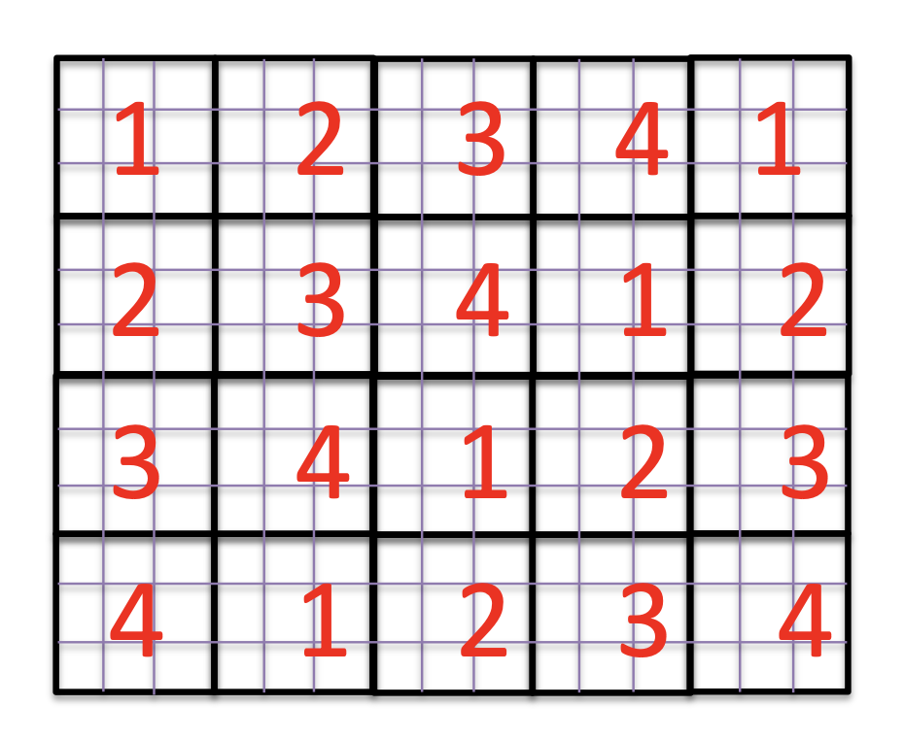
Data Distribution Techniques
Block cyclic (round robin) distribution

Slide 24
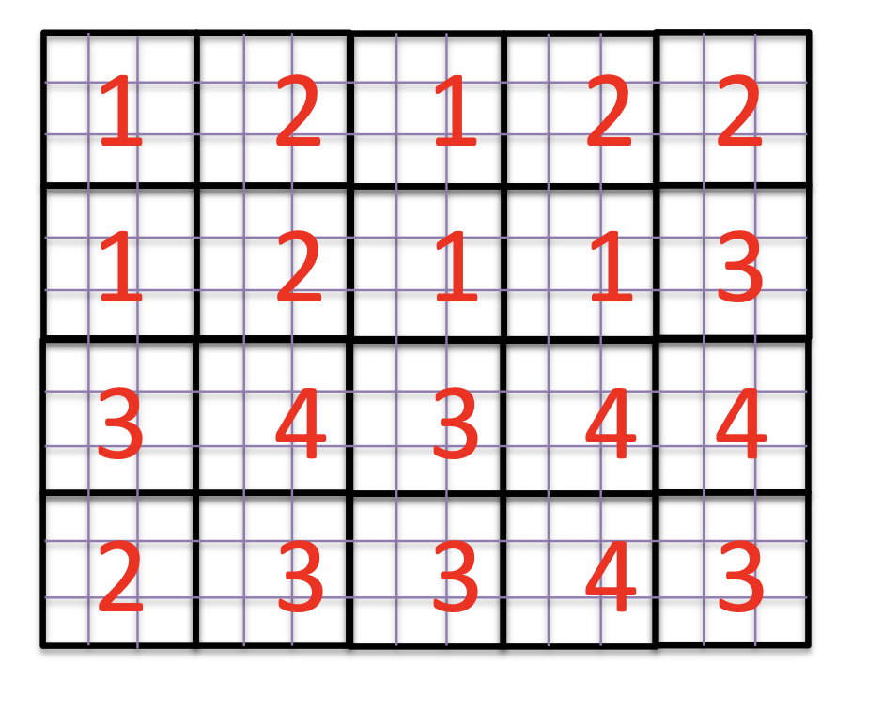
Data Distribution Techniques
Workload aware

Slide 25
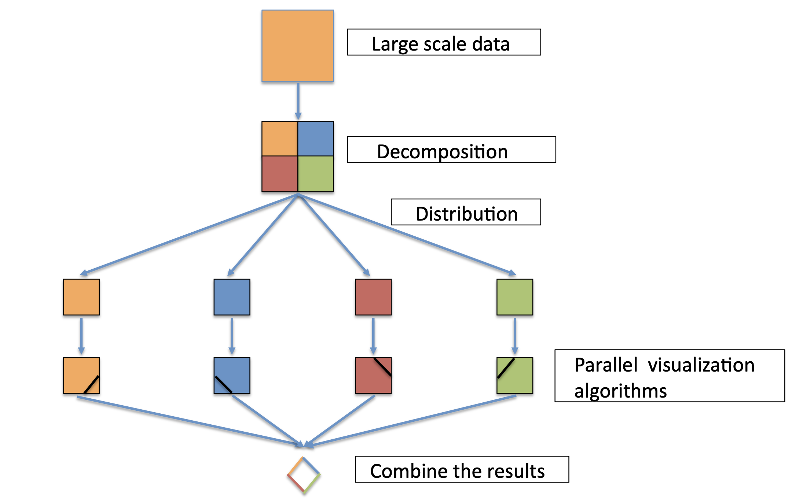
Parallel Data Processing and Aggregation of Partial Results

Slide 26
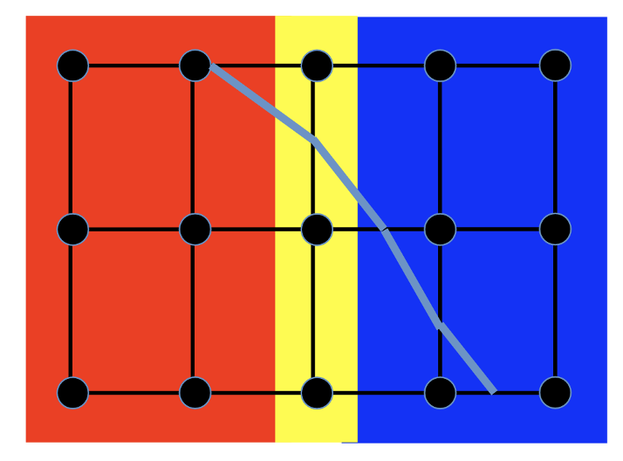
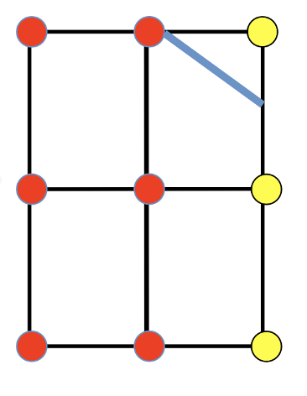
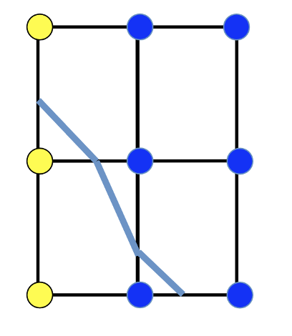
How to Ensure Continuity at Boundaries
Need ‘Ghost cells’
For interpolation-based tasks, we need to replicate and share boundary data points with neighboring processors
Cells in the duplicated layers are called ghost cells

Slide 27
Parallel Isosurface Extraction and Parallel Volume Rendering

Slide 28
Parallel Isosurface Extraction
Parallel Marching Cubes (Squares)
Observation: Each cell can be processed in parallel as there is no dependency among cells
Steps:
Divide the data into chunks of equal size
Each processing element (processor) runs Marching Cubes for the cells in the chucks that are assigned to it
Return the resulting triangles back to a master node, or render the triangles if parallel rendering is desired

Slide 29
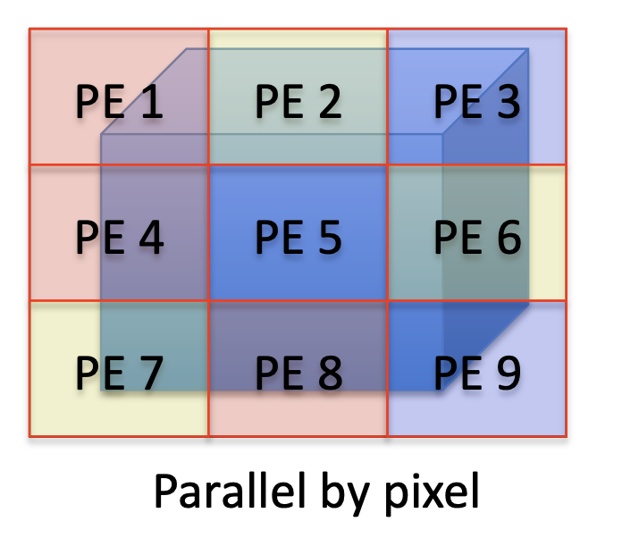
Parallel Volume Rendering
Parallel Volume Rendering
Parallel by pixel – Fits better for Shared memory approach
No image compositing needed
Little/no communication
Data often need to be replicated
Difficult to scale to large data

Slide 30
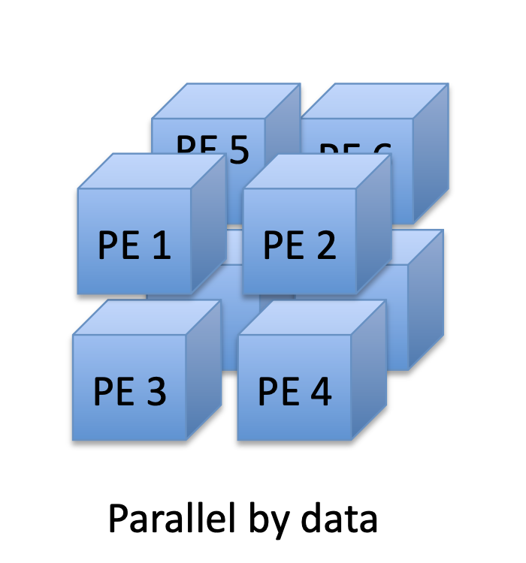
Parallel Volume Rendering
Parallel Volume Rendering
Parallel by pixel – Fits better for Shared memory approach
Parallel by data – Fits better for Distributed Memory approach
No image compositing needed
Data may need to be replicated
Difficult to scale to large data
Image compositing needed
More communication needed
Data are distributed
Easy to scale to large data

Slide 31
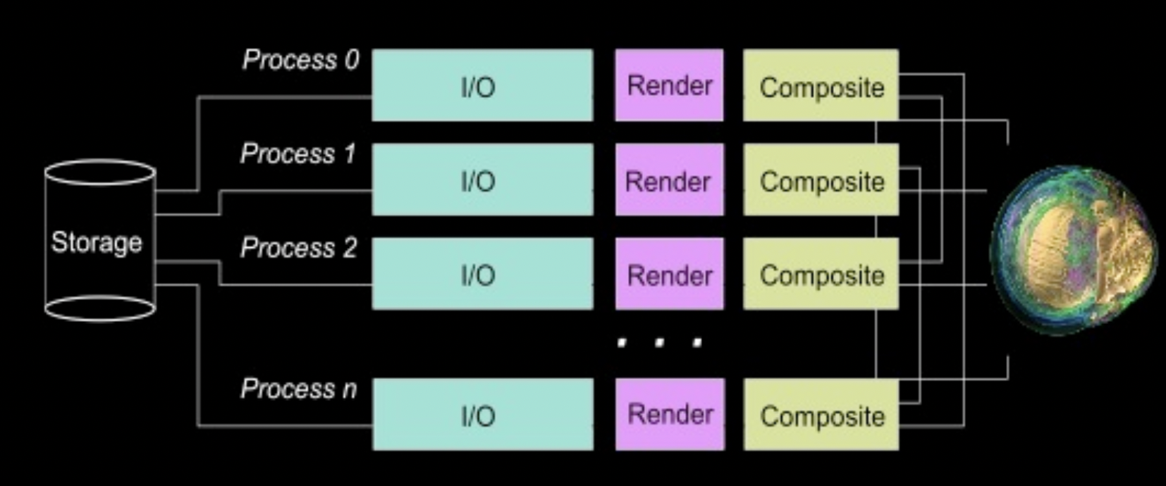
Parallel Volume Rendering
How to do this compositing in parallel efficiently?
Parallel Volume Rendering on the IBM Blue Gene/P, Peterka et al.

Slide 32
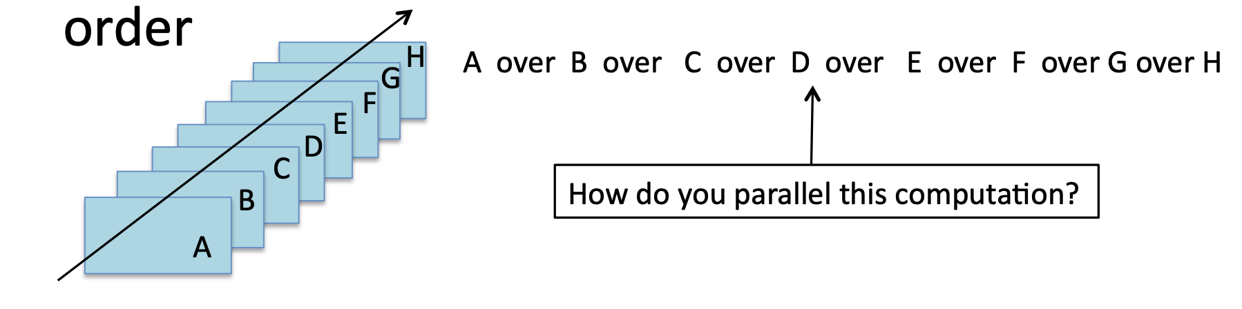
Parallel Image Compositing for Volume Rendering
Composite partial images generated from sub-domains
Minimize communication: send and receive images
Compositing needs to follow the visibility order of ray casting technique

Slide 33
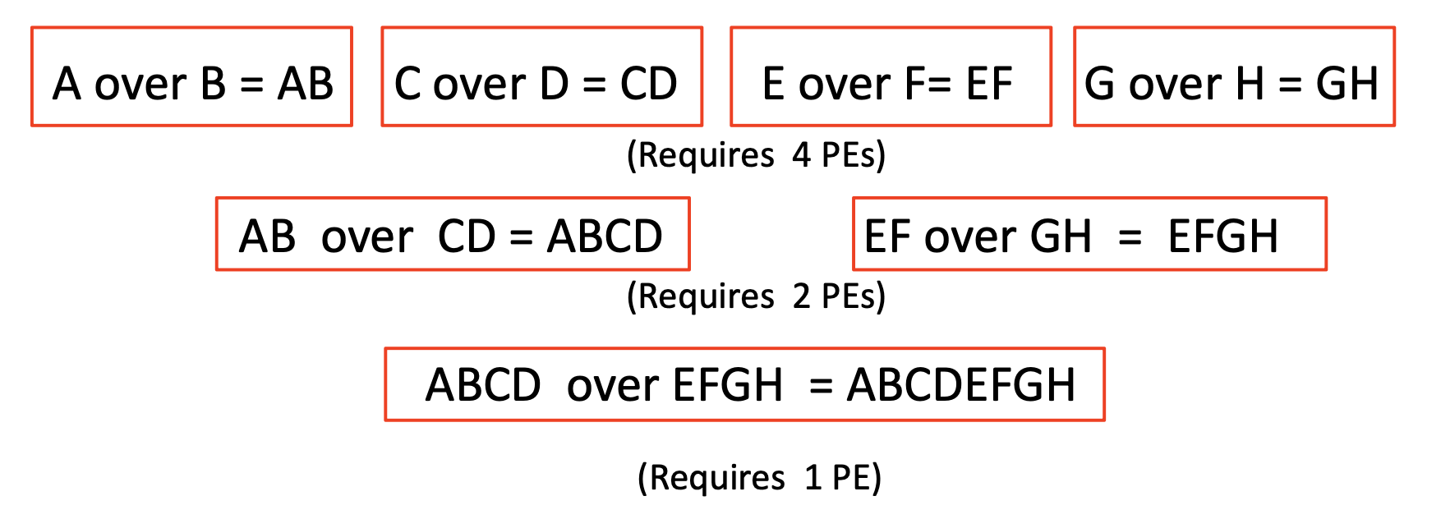
Parallel Image Compositing for Volume Rendering

Slide 34
Parallel Image Compositing for Volume Rendering
Load balancing is not good: Half of the processors are busy at every new stage

Slide 35
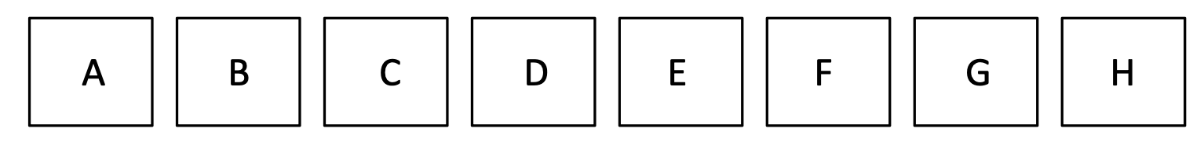
Parallel Image Compositing for Volume Rendering: A better strategy
keep every processor (PE) busy all the time
Recursive halving

Slide 36
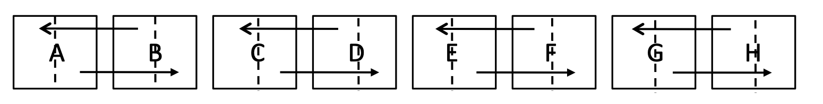
Parallel Image Compositing for Volume Rendering: A better strategy
keep every processor (PE) busy all the time
Recursive halving
Divide each image into two halves, and give half to the other PE to composite

Slide 37
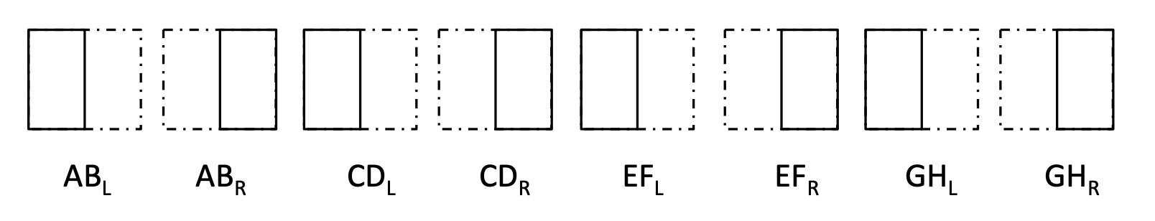
Parallel Image Compositing for Volume Rendering: A better strategy
keep every processor (PE) busy all the time
Recursive halving
Divide each image into two halves, and give half to the other PE to composite

Slide 38
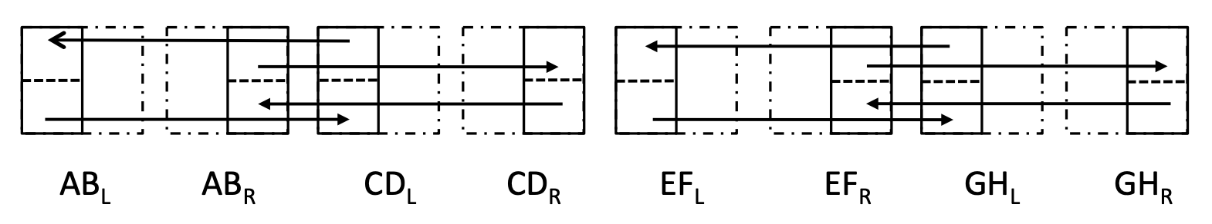
Parallel Image Compositing for Volume Rendering: A better strategy
keep every processor (PE) busy all the time
Recursive halving
Divide the half image further into top and bottom halves, and give it to the corresponding PE of to composite

Slide 39
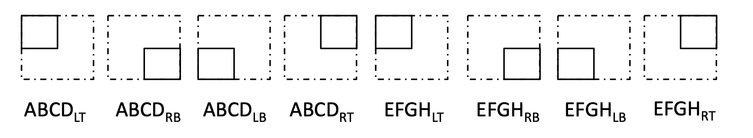
Parallel Image Compositing for Volume Rendering: A better strategy
keep every processor (PE) busy all the time
Recursive halving
Divide the half image further into top and bottom halves, and give it to the corresponding PE of to composite

Slide 40
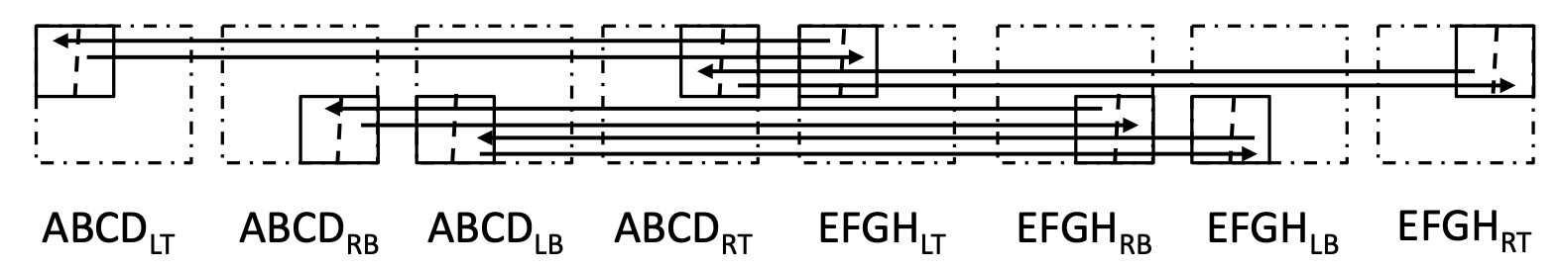
Parallel Image Compositing for Volume Rendering: A better strategy
keep every processor (PE) busy all the time
Recursive halving
Divide the 1/4 image further into left and right halves, and give it to the corresponding PE of to composite

Slide 41
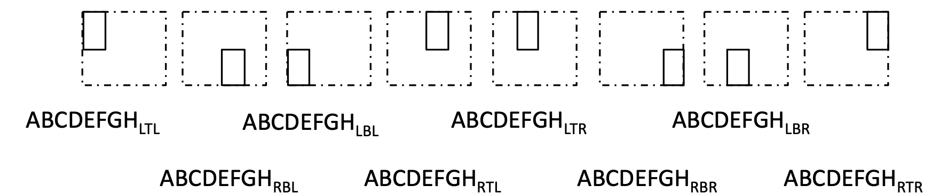
Parallel Image Compositing for Volume Rendering: A better strategy
keep every processor (PE) busy all the time
Recursive halving
Divide the 1/4 image further into left and right halves, and give it to the corresponding PE of to composite

Slide 42
Parallel Image Compositing for Volume Rendering: A better strategy
keep every processor (PE) busy all the time
Recursive halving
Divide the 1/4 image further into left and right halves, and give it to the corresponding PE of to composite
Load balanced approach: all workers are busy with equal workload at all the time

Slide 43
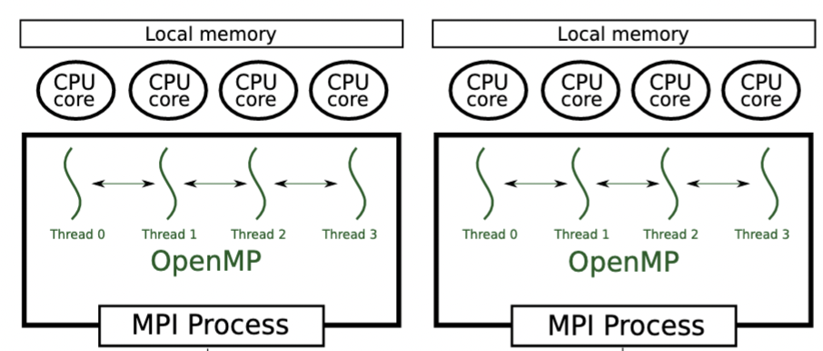
Hybrid Parallel Volume Rendering
Use MPI + OpenMP together to extract fine grained parallelism for very large-scale data set
Node A
Node B
Network
Static/Dynamic Analyses for Validation and Improvements of Multi-Model HPC Applications.

Slide 44
Hybrid Parallel Volume Rendering
Use MPI + OpenMP together to extract fine grained parallelism for very large-scale data set
Node A
Node B
Network
1/2 Data
1/2 Data
Data Decomposition
Static/Dynamic Analyses for Validation and Improvements of Multi-Model HPC Applications.

Slide 45
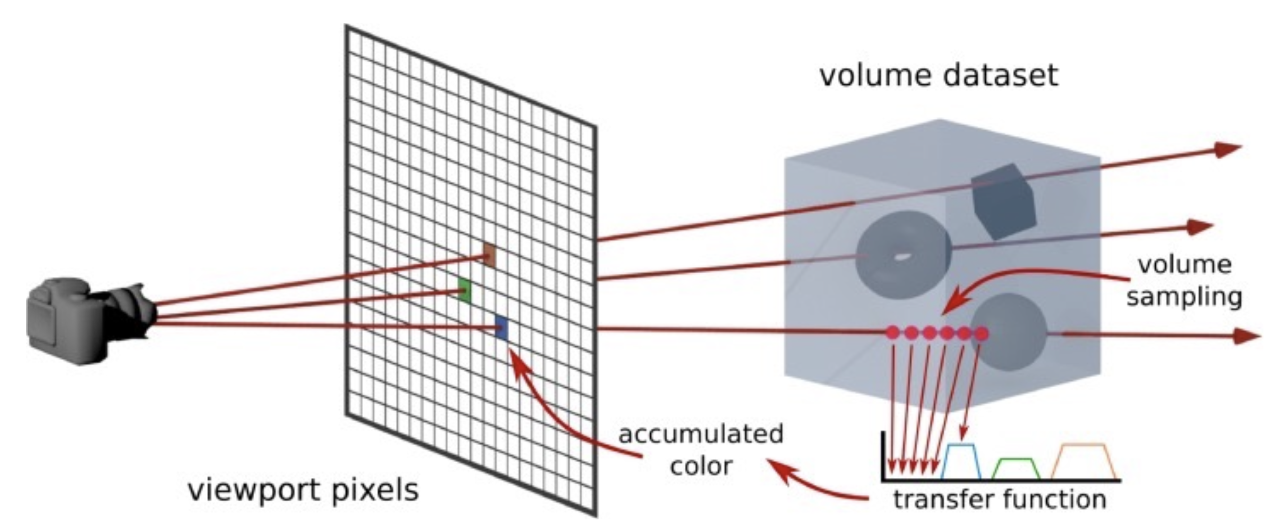
Hybrid Parallel Volume Rendering
Use MPI + OpenMP together to extract fine grained parallelism for very large-scale data set
Node A
Node B
Each OpenMP thread inside node A casts a ray into the sub-volume
Each OpenMP thread inside node B casts a ray into the sub-volume
Network
1/2 Data
1/2 Data
Data Decomposition
Static/Dynamic Analyses for Validation and Improvements of Multi-Model HPC Applications.

